Slide 1

Overview Jupyter notebook Crash course Python 3.x
Spring 2020 - week #1
Notes:
J

Slide 2
Start your engines
Head over to the RENKU webpage
https://renku.iccluster.epfl.ch
You will need the EPFL VPN if connecting from outside the EPFL network
Notes:
conda --version
conda update conda
conda info --envs or conda env list
conda create --name DSLab2019 python=3.7
conda activate DSLab2019
conda info --envs
python --version
conda search jupyter
conda install jupyter
conda list
conda search scikit-learn
# conda install scikit-learn=0.20.2=py37hebd9d1a_0
# conda list
conda deactivate
conda env remove -n DSLab2019

Slide 3

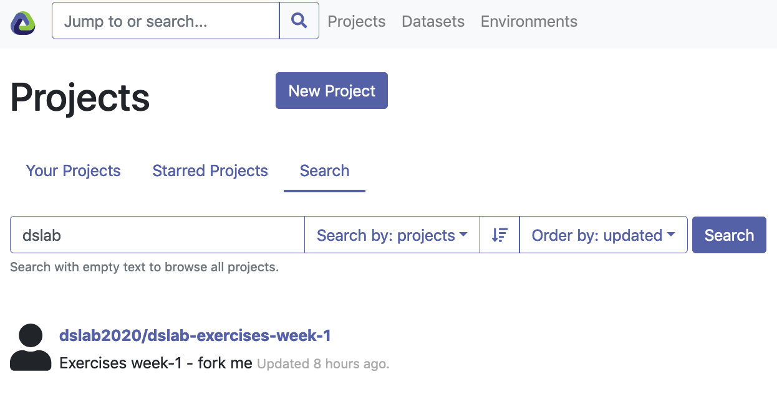
1. Login with your gaspar accounts
2. Find project dslab2020/dslab-exercises-week1

Slide 4
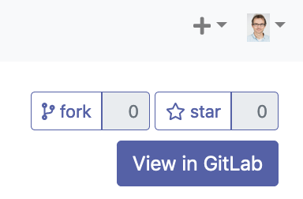
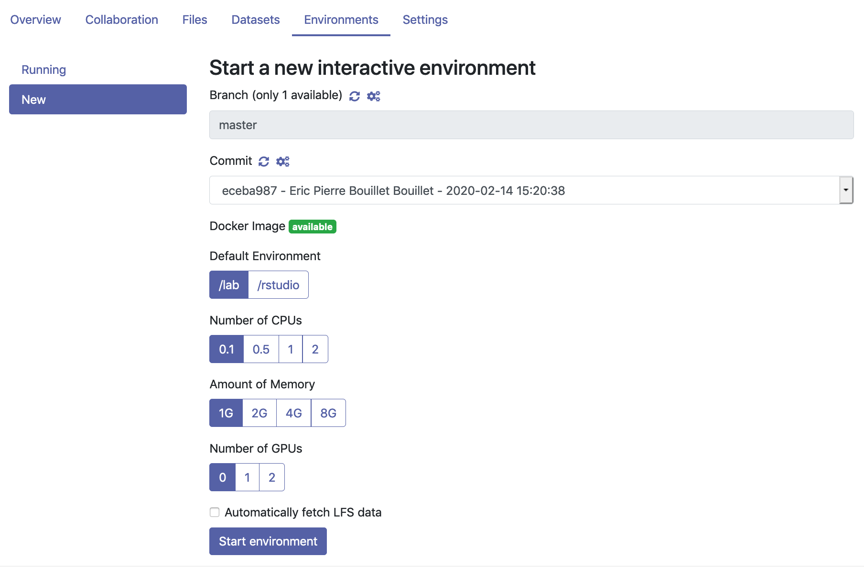
3. Open and fork project
4. Open forked project and start environment (1 CPU max)

Slide 5
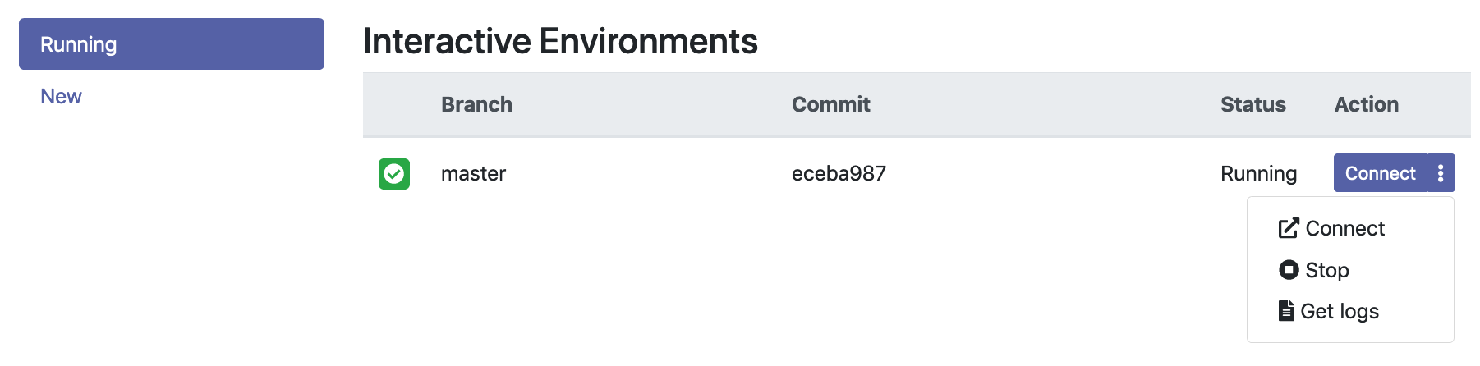
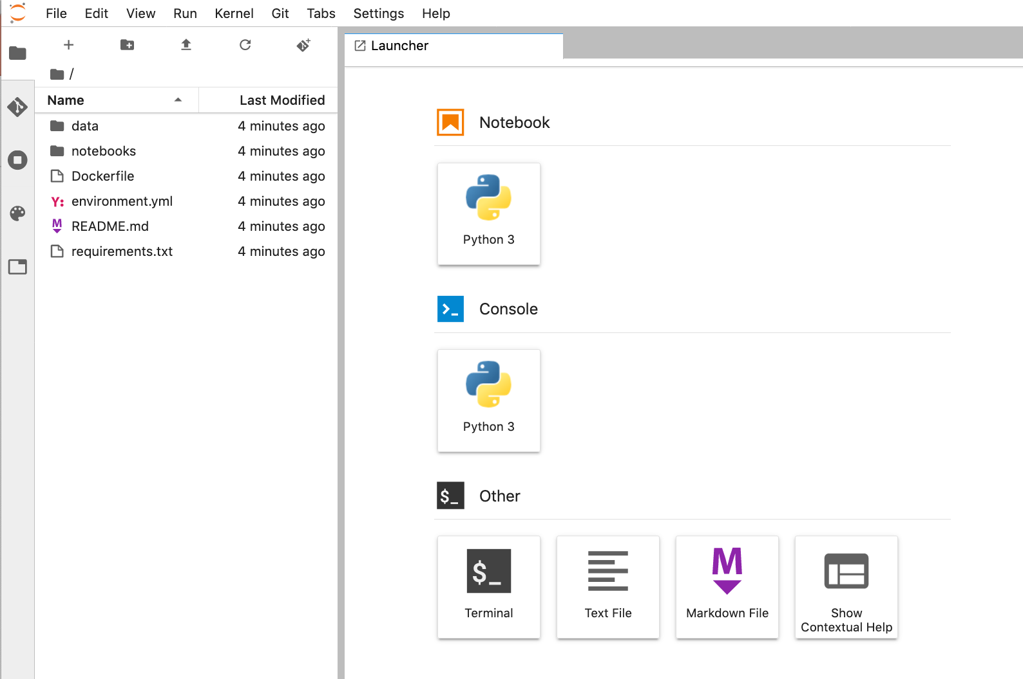
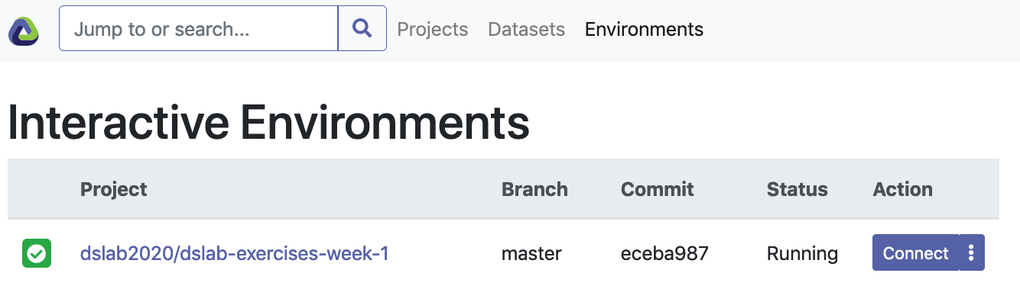
5. Open Jupyter Notebook
6. In Jupyter notebook, exercises are in notebook folder
7. Stop the environment when you are done
8. You can also access all your active environments

Slide 6
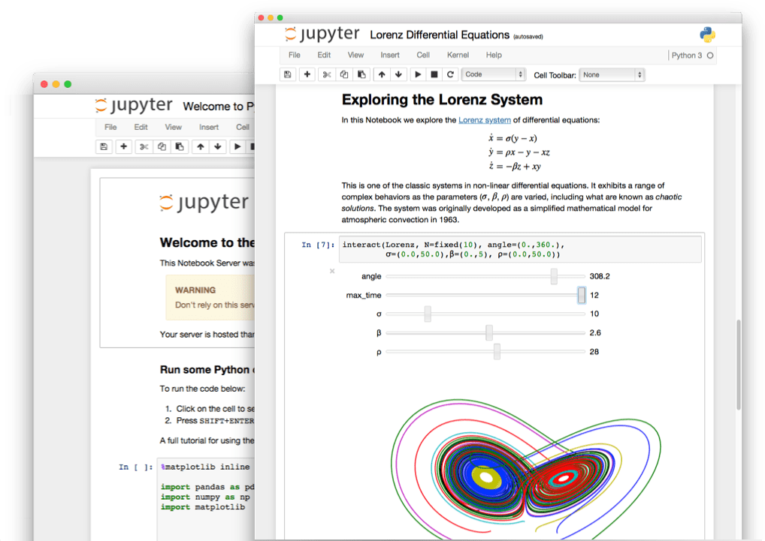
Overview Jupyter notebook
Spring 2020 - week #1
Notes:
J

Slide 7
What is a Jupyter notebook?
Open source web application
Development started in 2014 as spin-off from IPython
Notebooks denotes documents that contain both
Code, and rich text elements (figures, links, equations, etc)
Notebook documents produced by the Jupyter Notebook App
Client-server application to edit and run notebooks
Two main components: the kernels and a dashboard
Jupyter is a loose acronym meaning Julia, Python and R
Nowadays, Jupyter supports many other languages
Notes:
You could basically do many different things with a notebook… but it is heavily used these days to
Show a simple example:
a = 2
b = 3
Let’s compute $c = a^2 + b^2$
c = a**2 + b**2
print(c)
# & show \sqrt{.} in Latex
Show how to insert an image in a Markdown Cell
![alt text](Pictures/Compteur_Etage_1.jpg "Compteur")
Inline-style:
![alt text](https://github.com/adam-p/markdown-here/raw/master/src/common/images/icon48.png "Logo Title Text 1")
https://github.com/adam-p/markdown-here/wiki/Markdown-Cheatsheet
Show how to time block of code (cell) - %%timeit x = range(10000) max(x)

Slide 8
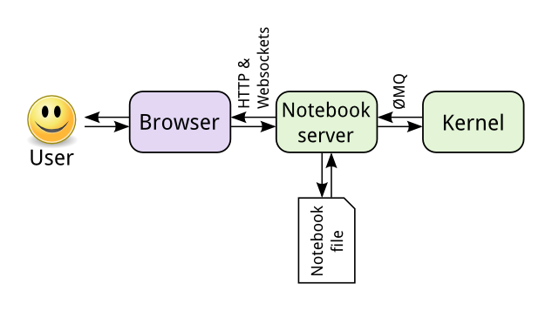
Jupyter is language-agnostic
The notebook server is responsible for saving and loading notebooks
The notebook is saved as a JSON file
The kernel gets sent cells of code to execute
Notes:
When you save a notebook, this is sent from your browser to the notebook server, which saves it on disk as a JSON file with a .ipynb extension.
JSON (JavaScript Object Notation) is a language-independent, human-readable open-standard file format (attribute-value pairs). It was derived from JavaScript.
The kernel doesn’t know anything about the notebook document: it just gets sent cells of code to execute when the user runs them.
** Show command lines as I create two new notebooks
** Explain that, as discussed before, we could install more kernels

Slide 9

Crash-course in Python 3.x
Spring 2020 - week #1
Notes:
J

Slide 10
Brief history of Python
Open source programming language
Conceived in the Netherlands by Guido van Rossum
Implementation started in December 1989
Python 2.x is legacy, Python 3.x is the present & future of the language
Python 2.0 released on October 16, 2000 (current: 2.7.15)
Python 3.0 released on December 3, 2008 (current: 3.7.3)
High-level, portable, interpreted, object-oriented
Notes:
2.7: 2010
3.6: late 2016
Guido van Rossum (the original creator of the Python language) decided to clean up Python 2.x properly, with less regard for backwards compatibility than is the case for new releases in the 2.x range. The most drastic improvement is the better Unicode support (with all text strings being Unicode by default) as well as saner bytes/Unicode separation.

Slide 11
Why Python?
Easy, Fast & Broad
Python Has a Healthy, Active and Supportive Community
Plenty of documentation, guides, tutorials and more
Incredibly active developer community
Python Has Some Great Corporate Sponsors
Google!
Python has Extensive Libraries
Notes:
C# has Microsoft
Java had Sun
PHP is used by Facebook
Google adopted Python heavily back in 2006

Slide 12
Python 3.x references
https://docs.python.org/3.7/tutorial/
Books include:
Learning Python by Mark Lutz
Python Essential Reference by David Beazley
Python for Data Analysis by William McKinney
https://github.com/justmarkham/DAT8#python-resources
Python Quick Reference
https://github.com/justmarkham/python-reference

Slide 13
Common pitfalls in Python
Incorrect indentation, tabs and spaces
Never use tabs, only spaces (4)
Using a mutable value as a default value
Scoping (local vs global variable)
Copying vs referencing (mutable types)
Notes:
def foo(param=None):
if param is None:
param = []
param.append(9)
return(param)
=====
bar = 42
def foo():
bar = 0 # !! bar = bar + 0 => local variable 'bar' referenced before assignment
# return(bar)
# bar = foo()
foo()
print(bar)
=====
b = a[:] same as b = a.copy()
=====

Slide 14
A few exercises in Python
Open the DSLab Week 1-1 Jupyter notebook
./notebooks/DSLab_week1_1.ipynb
Generators
List comprehension
Lambda Operator and the functions map() and reduce()
Lists of characters and the functions join() and append()
Notes:
Generators are functions that behaves like an iterator
why is it important to know them? as a (future) data scientist you should be careful with the way you handle big data
Comprehension
concise way to create lists, almost any expresion inside a bracket

Slide 15
NumPy, Pandas,
scikit-learn &
Matplotlib
Spring 2020 - week #1
Notes:
J

Slide 16
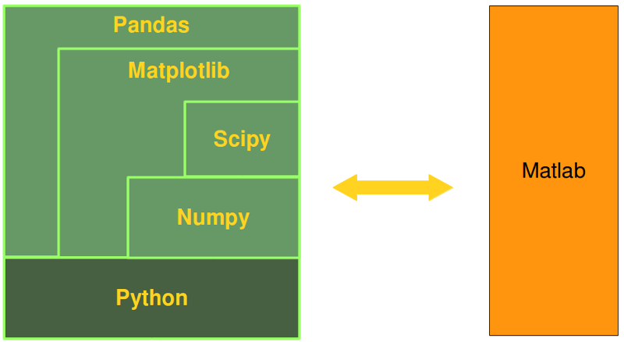
Python alternative to Matlab
Notes:
“Python in combination with Numpy, Scipy and Matplotlib can be used as a replacement for MATLAB. The combination of NumPy, SciPy and Matplotlib is a free alternative to MATLAB. Even though MATLAB has a huge number of additional toolboxes available, NumPy has the advantage that Python is a more modern and complete programming language and - as we have said already before - is open source. SciPy adds even more MATLAB-like functionalities to Python. Python is rounded out in the direction of MATLAB with the module Matplotlib, which provides MATLAB-like plotting functionality.”
Source: https://www.python-course.eu/numpy.php

Slide 17
Python libraries for (aspiring) data scientists
NumPy: Work with large multidimensional arrays and matrices
Pandas: Do data wrangling
Matplotlib: Make line graphs, pie charts, histograms, etc
Scikit-learn: Build machine learning models
Notes:
Scikit-learn built on top of Sci-pi

Slide 18
NumPy & Data Types
Core library for scientific computing in Python
Provides a high-performance multidimensional array object, and tools for working with these arrays
A NumPy array (ndarray) is a grid of values, all of the same type
indexed by a tuple of nonnegative integers
the shape of an array is the size of the array along each dimension

Slide 19
Python lists vs NumPy arrays
Functionality: SciPy and NumPy have optimized functions such as linear algebra operations built in
Performance: need for speed and are faster than lists
Size: Numpy data structures take up less space
list: 64 + n*8 + n*28 bytes
ndarray: 96 + n*8 bytes
a.
b.
Notes:
Size - Numpy data structures take up less space
Performance - they have a need for speed and are faster than lists
Functionality - SciPy and NumPy have optimized functions such as linear algebra operations built in.
Python lists vs numpy arrays
Speed
import numpy as np
N = 1000
%%timeit
X = range(N)
Y = range(N)
#Z = [X[i]+Y[i] for i in range(len(X)) ] # slow
#Z = [ x+y for x,y in zip(X,Y) ] # fast
%%timeit
X = np.arange(N)
Y = np.arange(N)
Z = X + Y
The difference is mostly due to "indirectness" -- a Python list is an array of pointers to Python objects, at least 4 bytes per pointer plus 16 bytes for even the smallest Python object (4 for type pointer, 4 for reference count, 4 for value -- and the memory allocators rounds up to 16). A NumPy array is an array of uniform values -- single-precision numbers takes 4 bytes each, double-precision ones, 8 bytes. Less flexible, but you pay substantially for the flexibility of standard Python lists!

Slide 20
Relevant NumPy functions
arange([start,] stop[, step], [, dtype=None])
linspace(start, stop, num=50, endpoint=True, retstep=False)
Checkout logspace & geomspace
reshape(array, newshape, order=‘C’)
copy(obj, order='K’)
Indexing and slicing arrays

Slide 21
What is Matplotlib?
Plotting library

Slide 22
Relevant Matplotlib functions
Functions: plot, subplot, scatter and annotate
%matplotlib {inline, notebook}
matplotlib.get_backend()
Notes:
matplotlib.get_backend will show the backend used for rendering and GUI integration

Slide 23
Other visualization libraries
Seaborn: Python's Statistical Data Visualization Library
high-level interface to draw statistical graphics
https://seaborn.pydata.org/
Bokeh: Python interactive visualization library
interactive plots, dashboards, and data applications
https://bokeh.pydata.org/en/latest/

Slide 24
Pandas & Pandas Data Frames
Powerful & flexible data munging library
Pandas was built on NumPy
NumPy stores your data in arrays
Pandas takes the NumPy Array…
… and gives you a labeled index to it
Pandas DataFrame is a 2-D labeled data structure with columns of potentially different types
Basically, dictionary-based NumPy arrays
Recommended reading (before doing the exercises)
https://chrisalbon.com/python/data_wrangling/pandas_apply_operations_to_groups/
Notes:
Pandas makes the least sexy part of the "sexiest job of the 21st Century" a bit more pleasant.

Slide 25
Scikit-learn: Machine Learning in Python
http://scikit-learn.org/stable/index.html
Open source, built on NumPy, SciPy, and matplotlib
Classification
Regression (Logistic Regression)
Clustering (KMeans)
Dimensionality reduction (PCA)
Model selection
Preprocessing
Notes:
Classification
Identifying to which category an object belongs to.
Regression
Predicting a continuous-valued attribute associated with an object.
Clustering
Automatic grouping of similar objects into sets.
Dimensionality reduction
Reducing the number of random variables to consider.
Model selection
Comparing, validating and choosing parameters and models.
Preprocessing
Feature extraction and normalization.

Slide 26
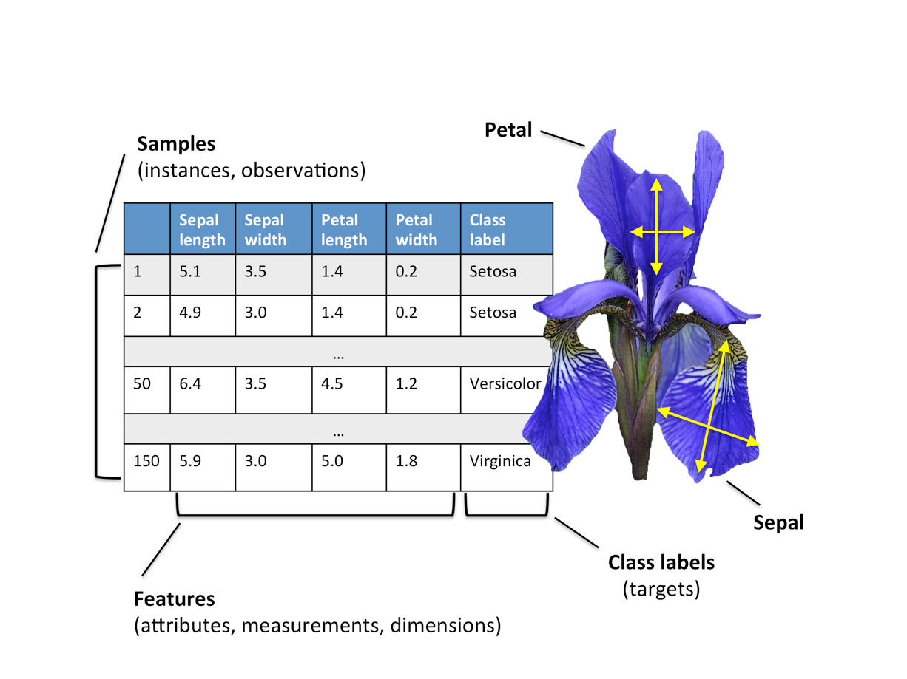
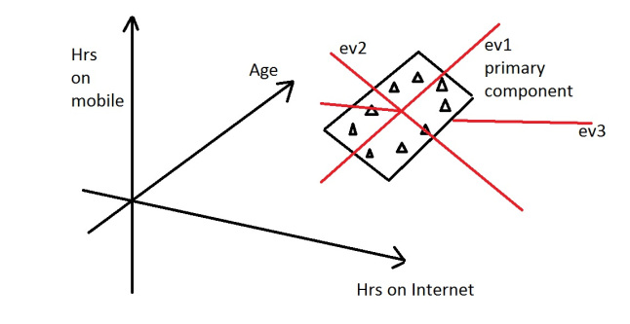
Principal Component Analysis (PCA)
sklearn.decomposition.PCA()
(Linear) dimensionality reduction using SVD of the data to project it to a lower dimensional space
Maximize the variance in the low-dimensional representation
Take e.g. the Iris dataset
Example
Notes:
Linear mapping of thSingular Value Decomposition (SVD)e data

Slide 27
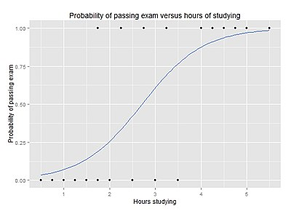

Logistic Regression
sklearn.linear_model.LogisticRegression()
Model used for prediction of the probability of occurrence of an event by fitting data to a logistic curve
Standard industry workhorse!
Chaining a PCA and a logistic regression
Notes:
supervised learning
developed by statistician David Cox in 1958
model is a direct probability model and not a classifier.
Fraud detection, product recommendation, etc

Slide 28
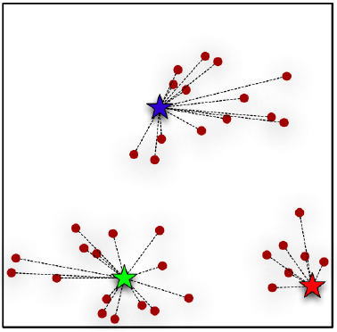
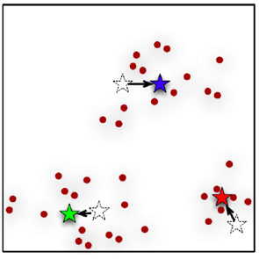
Kmeans – Clustering algorithm
sklearn.cluster.KMeans()
Find similarity groups in a data, called clusters
Randomize K points, then two-step iterative algorithm:
1. Cluster assignment step
2. Move centroid step.
Notes:
unsupervised learning
Pick K
In Cluster assignment step, the algorithm goes through each of the data points and depending on which cluster is closer, whether the red cluster centroid or the blue cluster centroid or the green; It assigns the data points to one of the three cluster centroids.
In move centroid step, K-means moves the centroids to the average of the points in a cluster. In other words, the algorithm calculates the average of all the points in a cluster and moves the centroid to that average location.
repeated until there is no change in the clusters

Slide 29
Exercises … a bit harder/longer
Open DSLab Week 1 Jupyter notebooks in Renku
./notebooks/DSLab_week1-2.ipynb
NumPy arrays & Matplotlib
./notebooks/DSLab_week1-3.ipynb
Getting familiar with Pandas
Simple Machine Learning problems

Slide 30
Thank you!

